Slide 1
Community Based Surveillance Technically
Einar Ingebrigtsen
Principal Technical Evangelist
Notes:
Microsoft Philantropies -> Azure Consumption
@ Microsoft – every employee get to devote 3 days a year to a cause of their choice.

Slide 2
What are we building

Slide 3
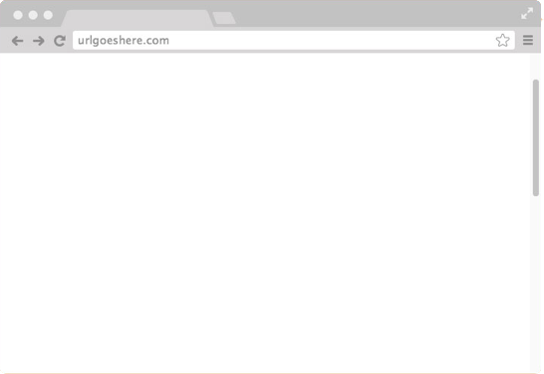

In the office
Admin
Alerts
Reporting
Volunteer Reports
User management
IFRAME
Or something else…

Slide 4
In the field
Alerts
Volunteer Reports
User management
Volunteer Reports

Slide 5
Goals

Slide 6
Developing
Build it smart
Reduce cost
Reduce risk
Build for maintainability – sustainable software
Build with high quality
Build as fast as possible
Easy to provision new countries
Notes:
Red Cross does not have their own developers. The whole thing has to be designed in a way that enables them to get it built by anyone, by potentially multiple teams.
Break dependencies to specific people

Slide 7
Architecture

Slide 8
Core Principles
Going smaller; Microservices
Domain Driven Design; Bounded Contexts
Event Driven – the contract
Reduce risk
Improve throughput
Allowing autonomous teams
Automated; DevOps
Behavior Driven Development
Load Testing
Configuration as Code
Notes:
Events will improve on autonomous teams

Slide 9
Containers
Docker based
Registry
Holds all the versions
Orchestrator
Azure Container Service; Kubernetes
Notes:
Why containers:
Clear strategy for packaging and versioning software with all its dependencies
Orchestrator would act as orchestrating all the workloads
Flexibility – design for any type environment – making it easier to get things built
Flexibility through tech:
.NET Core, NodeJS, Java, Ruby

Slide 10
Code Decisions
Backend
.NET Core
C#
Autofac – IoC Container
ASP.NET Core
Angular w/Typescript
Notes:
Intro: Why are we making these decisions; majority of the attendees are .NET devs and Angular on the frontend – limit the surface area - maintainability
Even if you’re not a C# dev. We need you. Development is not about the programming language, but the actual problem solving – solving the business problems.
It does not mean we don’t like other tech – hard decisions had to me made.

Slide 11
Database Decisions
MongoDB – CosmosDB w/MongoDB interface
If needed:
SQL Server
Elastic Search / Azure Search
Gremlin based Graph (Neo4J, CosmosDB)
Notes:
Document First
Relational if needed
Spice up with Search Index / Graph
Lets discuss the need when and if it arise – Core team needs to be involved

Slide 12
High Level
Bounded Context A
Bounded Context B
Frontend
Frontend
Backend
Backend
Data
Events
Data
Events
Messaging Infrastructure
Event Store
Notes:
Why…
Autonomous teams
Future proofing
Audit trails
Capture the real state changes in the system

Slide 13
Diving In
Frontend (Web)
Styling
(SCSS)
View
(HTML)
Controller
(TypeScript)
Backend
Controller
Validation
Authorization
Queries
Commands
Event
Event Processor
Event Emitter
Messaging infra.
Data
Event Store

Slide 14
The Code

Slide 15
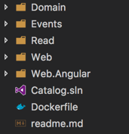
Folder Structure

Slide 16
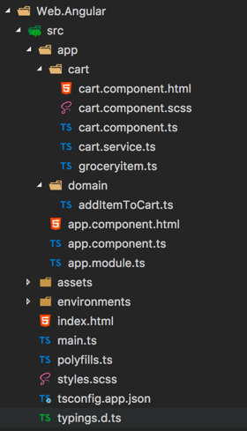
Angular
Notes:
Angular CLI
Described on GitHub on how..

Slide 17
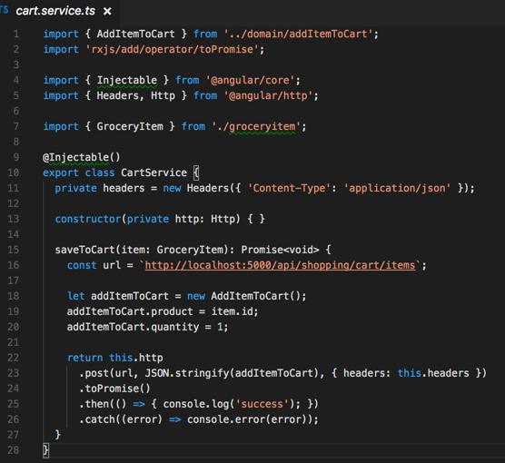
Angular – Calling Backend

Slide 18
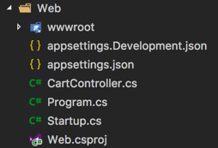
Web - Backend

Slide 19
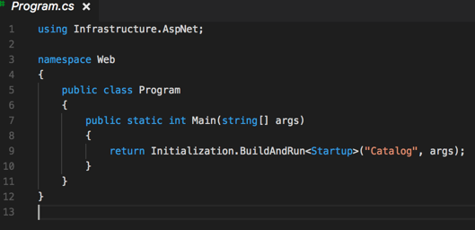
Web - Backend

Slide 20
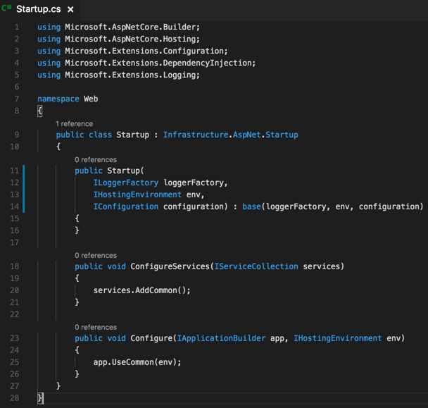
Web - Backend

Slide 21
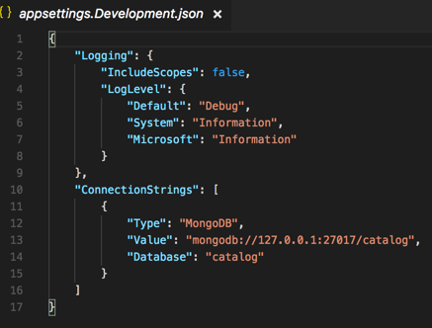
Web - Backend

Slide 22
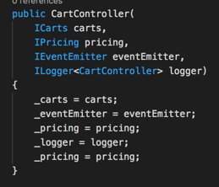
Web – Backend - Controller

Slide 23
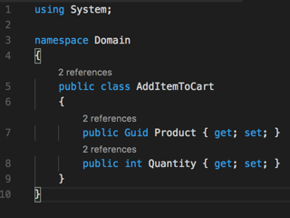
Domain - Commands

Slide 24
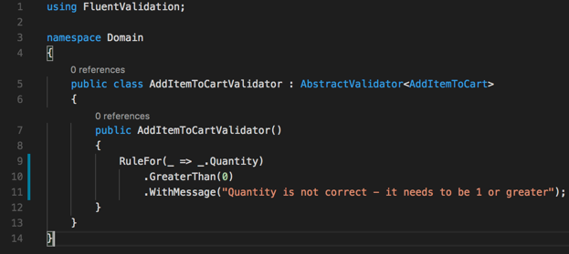
Domain – Commands - Validation

Slide 25
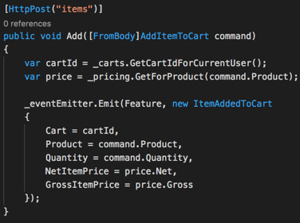
Web – Backend – Controller Action

Slide 26
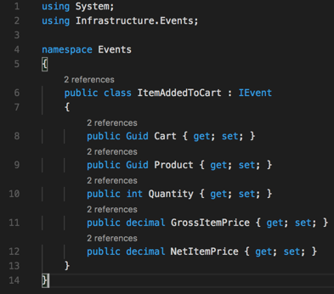
Events

Slide 27
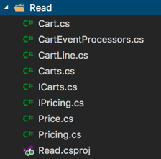
Read

Slide 28
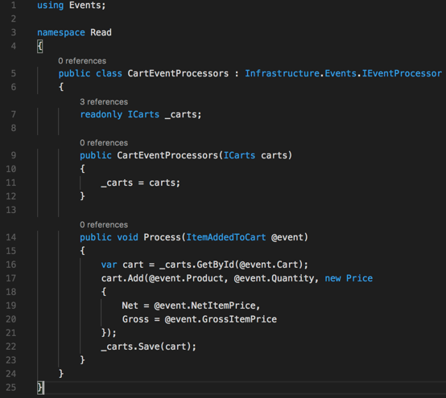
Read - EventProcessor

Slide 29
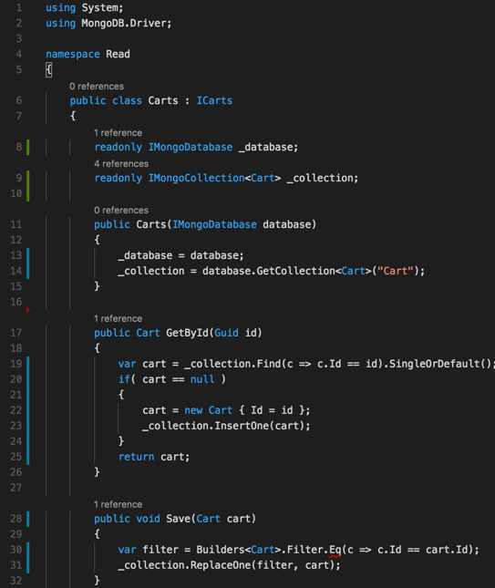
Read - Repository

Slide 30
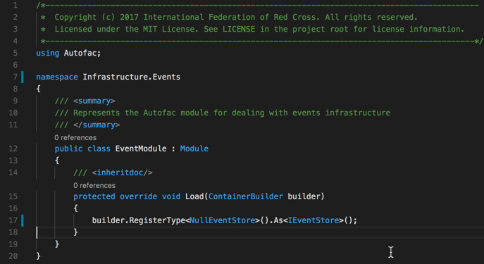
Autofac

Slide 31
Whats missing

Slide 32
What about testing
We strongly recommend you do testing
.NET Code you have many options
Xunit
Nunit
Mspec
NBehave
…and more…
Angular side of things
Karma
Jasmine
Protractor
Notes:
Up to the team
Selenium - don’t have a strategy

Slide 33
Environment
Local Distributed Event Stream
Event Store
There are no events from the other bounded contexts – Fake it.
Potentially do an events controller – ingest from Postman

Slide 34
Events
Versioning -> Migrations
Mediators -> between different bounded contexts
Replay
Automatic replay for new event processors
Where are the event definitions? Schema…???
Metadata
Notes:
There is no consistent Event list – some places they are defined, some not – some you get a hint of that they are

Slide 35
Identity & Access (Authentication & Authorization)
There will be an Identity Server - assume you’re authenticated. We’ll get back to ya.. ☺
OAUTH2 + OpenID
Social Providers
Azure AD + B2C

Slide 36
Contributions

Slide 37
Source Control
GIT
Everyone has their own fork
tip: You can add any fork as a remote (good for team work)
Commits associated with issues (#<issue>)
Pull Requests -> origin
Notes:
Pull requests – do it as often as it makes sense.
Feedback loop. Get the feedback loop down.

Slide 38
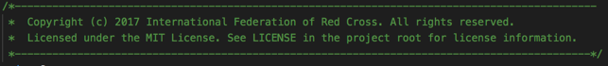
Headers
Notes:
Codesnippets
Could this be automated

Slide 39
Expectations
Try to stay within the structure, but please discuss with Core team if you see a reason not to – or improvements! Maybe we should change for all.
Nothing is written in stone; if you have input – talk with someone on the Core team.
Share your ideas
Be open to new ideas
Don’t be afraid to ASK – no stupid questions!
HAVE FUN!!!

